Slide 1
Agile Software Development and Scrum Methodology
BY
DIVYALAKSHMI M

Slide 2
Introduction to Agile Software Development
Definition: Agile is a set of principles for software development under which requirements and solutions evolve through collaborative effort.

Slide 3





12 Key Principles of Agile:
Satisfy the customer through early and continuous delivery.
Welcome changing requirements, even late in development
Deliver working software frequently
Collaboration between business stakeholders and developers
Build projects around motivated individuals

Slide 4


Regular reflection and adaptation
Self-organizing teams
Face-to-face communication is most effective.
Working software is the primary measure of progress.
Sustainable development phase.
Continuous attention to technical excellence.
Simplicity is essential.

Slide 5
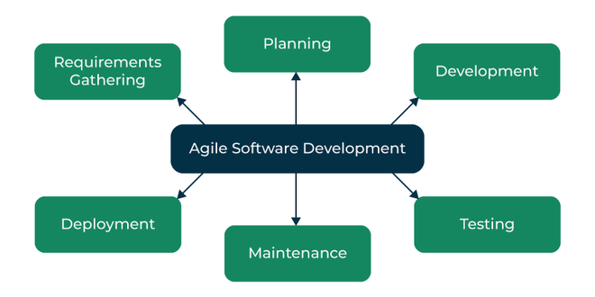
Software Development Lifecycle:
Requirements Gathering – Collect and prioritize customer requirements.
Planning – Define iterations and delivery roadmap.
Development – Build software through rapid iterations.
Testing – Ensure quality and requirement fulfillment.
Deployment – Release software for use.
Maintenance – Continuously improve and support the software.
.

Slide 6
Customer Satisfaction – Continuous feedback ensures needs are met.
Faster Delivery – Quick iterations speed up release.
Lower Risk – Frequent testing catches issues early.
Better Collaboration – Strong teamwork improves efficiency.
Flexible & Adaptable – Easily accommodates changes.
Higher Quality – Continuous testing ensures reliability.
More Transparency – Regular updates build trust.
Advantages of Agile

Slide 7
SCRUM METHODOLOGY
A management framework for self-organizing teams.
Enables collaboration and efficient task management.
Follows an iterative and incremental approach.
Adapts to changing requirements easily.
Ensures high productivity and creativity.
Focuses on delivering high-value products.

Slide 8
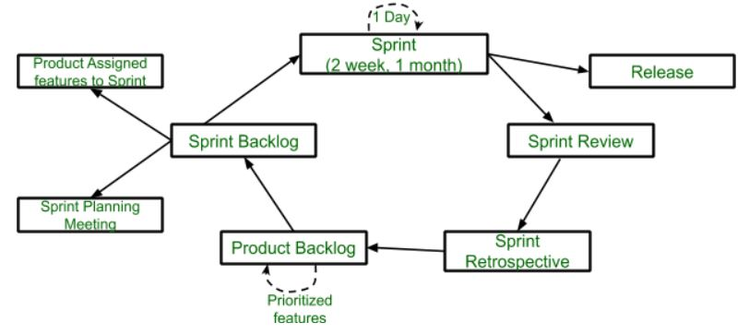
Scrum Components:
Sprint – Time-boxed (≤1 month), starts immediately after the previous one.
Release – Final stage when the product is completed.
Sprint Review – Checks non-achievable features before the retrospective.
Sprint Retrospective – Evaluates product quality and status.
Product Backlog – Organized list of prioritized features.
Sprint Backlog – Divided into assigned features and sprint planning.

Slide 9
Fast & Cost-Efficient – Ensures quick development and budget control.
Divide & Conquer – Breaks large products into manageable sub-products.
Customer-Centric – Prioritizes customer satisfaction.
Highly Adaptive – Short sprints allow flexibility.
Improved Quality – Continuous feedback enhances product quality quickly.
Advantages

Slide 10
Conclusion
Agile and Scrum are powerful methodologies for modern software development.
They emphasize collaboration, adaptability, and delivering value to customers.
Organizations must embrace Agile principles to stay competitive in a fast-changing world.

Slide 11
THANK YOU
ANY QUESTIONS ?

